Slide 1


Slide 2
01 · PROJECT OVERVIEW
What is RePlate?
A digital platform that connects food businesses, municipalities and citizens to redistribute surplus food, reduce waste and support local communities.
20
4
11
Functional requirements
Agile sprints
Stakeholder groups
Platform highlights
✓
Interactive surplus food map
↗
Two-stage redistribution model
Nearby branches and available products shown by location.
Direct user pickup first; unclaimed food moves to municipal centers.
✓
Meal & pet food donations
↗
Business & municipality dashboards
Aid for people in need and animal shelters.
Surplus, stock, transfers, donations and impact analytics.
✓
Real-time notifications
↗
Personal impact tracker
Reservation updates, favorite branch alerts and price changes.
Users see money saved, meals rescued and environmental impact.
RePlate · SE 216 Software Project Management · Group 7

Slide 3
02 · PROJECT INTRODUCTION
Problem, solution and overall goal
The Problem
Our Solution — RePlate
• Restaurants, cafés and supermarkets discard edible food due to overproduction and end-of-day surplus.
• People with limited resources struggle to access affordable meals.
• Existing platforms do not coordinate municipalities and businesses in one structured redistribution system.
• One coordinated network connects restaurants, food businesses, municipalities and citizens.
• Users reserve directly from businesses; uncollected food is automatically transferred to distribution centers.
• Donation flows and analytical dashboards provide measurable environmental and social impact.
Overall goal
Build a traceable food redistribution platform that reduces waste, supports vulnerable communities and creates measurable environmental impact.
RePlate · SE 216 Software Project Management · Group 7

Slide 4
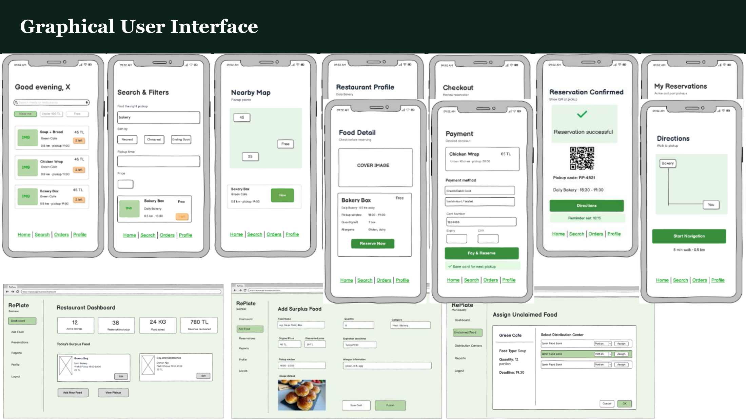

Slide 5
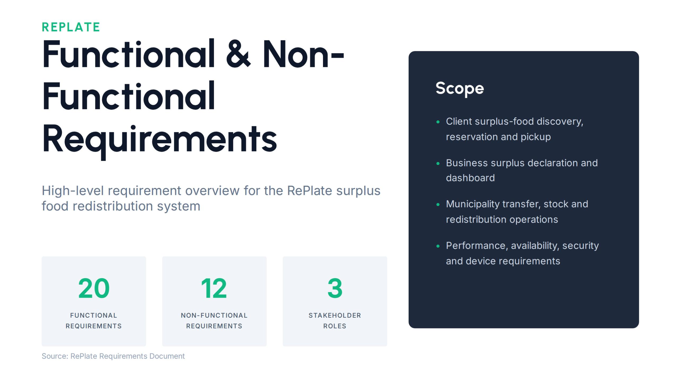

Slide 6
01.
Key Functional Requirements (FR)
What the RePlate system must do, grouped by stakeholder workflow.
👤
🏪
🏛
Core Client Experience
Business & Stock Logic
Redistribution & Municipality
FR-1 to FR-10, FR-16, FR-19
FR-11, FR-14, FR-15, FR-20
FR-12, FR-13, FR-17, FR-18
Separate login forms for municipalities, business owners and clients.
User registration/login with email or phone and profile creation.
Interactive map with user location and nearby branches with available products.
Map/list filtering by category, price range, distance, expiration date and stock quantity.
Product details: name, category, prices, expiration date, quantity, branch and pickup window.
Reservation with unique reservation code and QR code; cancellation up to 30 minutes before pickup.
Push notifications, favorite branches, priority notifications, impact dashboard and secure in-app payment.
Businesses register on the platform and are verified before activation.
Businesses declare surplus food with name, category, quantity, expiration date, photo and pickup time.
System detects products close to expiration and suggests listing them.
Business dashboard shows surplus declarations, waste reduction rates and donation contributions.
Products within 24 hours of expiration receive dynamic pricing suggestions.
Product status updates automatically based on actions and time limits: available, reserved, picked-up, expired, donated and bio-waste.
Two-stage model: users reserve and collect directly from businesses within a defined time window.
If a product is not collected in time, it transfers automatically to municipal distribution centers.
Distribution centers view incoming transfers, track current stock and process pickup with QR scanning.
Users can donate meals for people in need and pet food for animal shelters.
Municipalities monitor reported surplus food, track transfers, manage redistribution and analyze regional food data.
QR
LIVE
24H
2-STAGE
CO₂
PICKUP VERIFICATION
STOCK UPDATES
DYNAMIC PRICING
REDISTRIBUTION
IMPACT
RePlate Requirements
SE 216 Software Project Management

Slide 7
02.
Non-Functional Requirements (NFR)
Quality attributes the RePlate system must satisfy during operation.
<3s
99%
5m
10K
AES-256
SEARCH & FILTER RESULTS
UPTIME / 24×7
CRASH RESTART
CONCURRENT USERS
DATA ENCRYPTION
⚡
⏱
🔒
📱
Performance & Scale
Availability & Recovery
Security & Access
Usability & Compatibility
NFR-1, NFR-7
NFR-2, NFR-3, NFR-12
NFR-4, NFR-5, NFR-12
NFR-6, NFR-9, NFR-11
Search and filter results must return in less than 3 seconds under normal network conditions.
The system must support at least 10,000 concurrent users.
Core operations such as search, reserve and update must stay below 3 seconds.
The system must maintain at least 99% uptime and be accessible 24/7.
After a crash or unexpected failure, the system must restart within 5 minutes.
Error rate must stay below 1% during normal operation.
Downtime during updates must not exceed 5 minutes.
Personal data, payment information and reservation data must be stored securely using AES-256 encryption.
Data transmission must use secure protocols: SSL/TLS.
Only authorized administrators should access management panels and sensitive business data.
Critical security patches must be applied within 48 hours of detection.
At least 90% of users must complete a product reservation within 3 minutes without external assistance.
The app must support Android 10+ and iOS 14+.
It must function on 4.7–6.7 inch screens with at least 4GB RAM.
GPS location error margin must be at most 25 meters.
NFR-8
Backups every day at 02:00 AM, completed before 03:00 AM, retained for at least 7 days.
NFR-10
Modular architecture: new features require changes to no more than 15% of the existing non-UI codebase.
RePlate Requirements
SE 216 Software Project Management

Slide 8
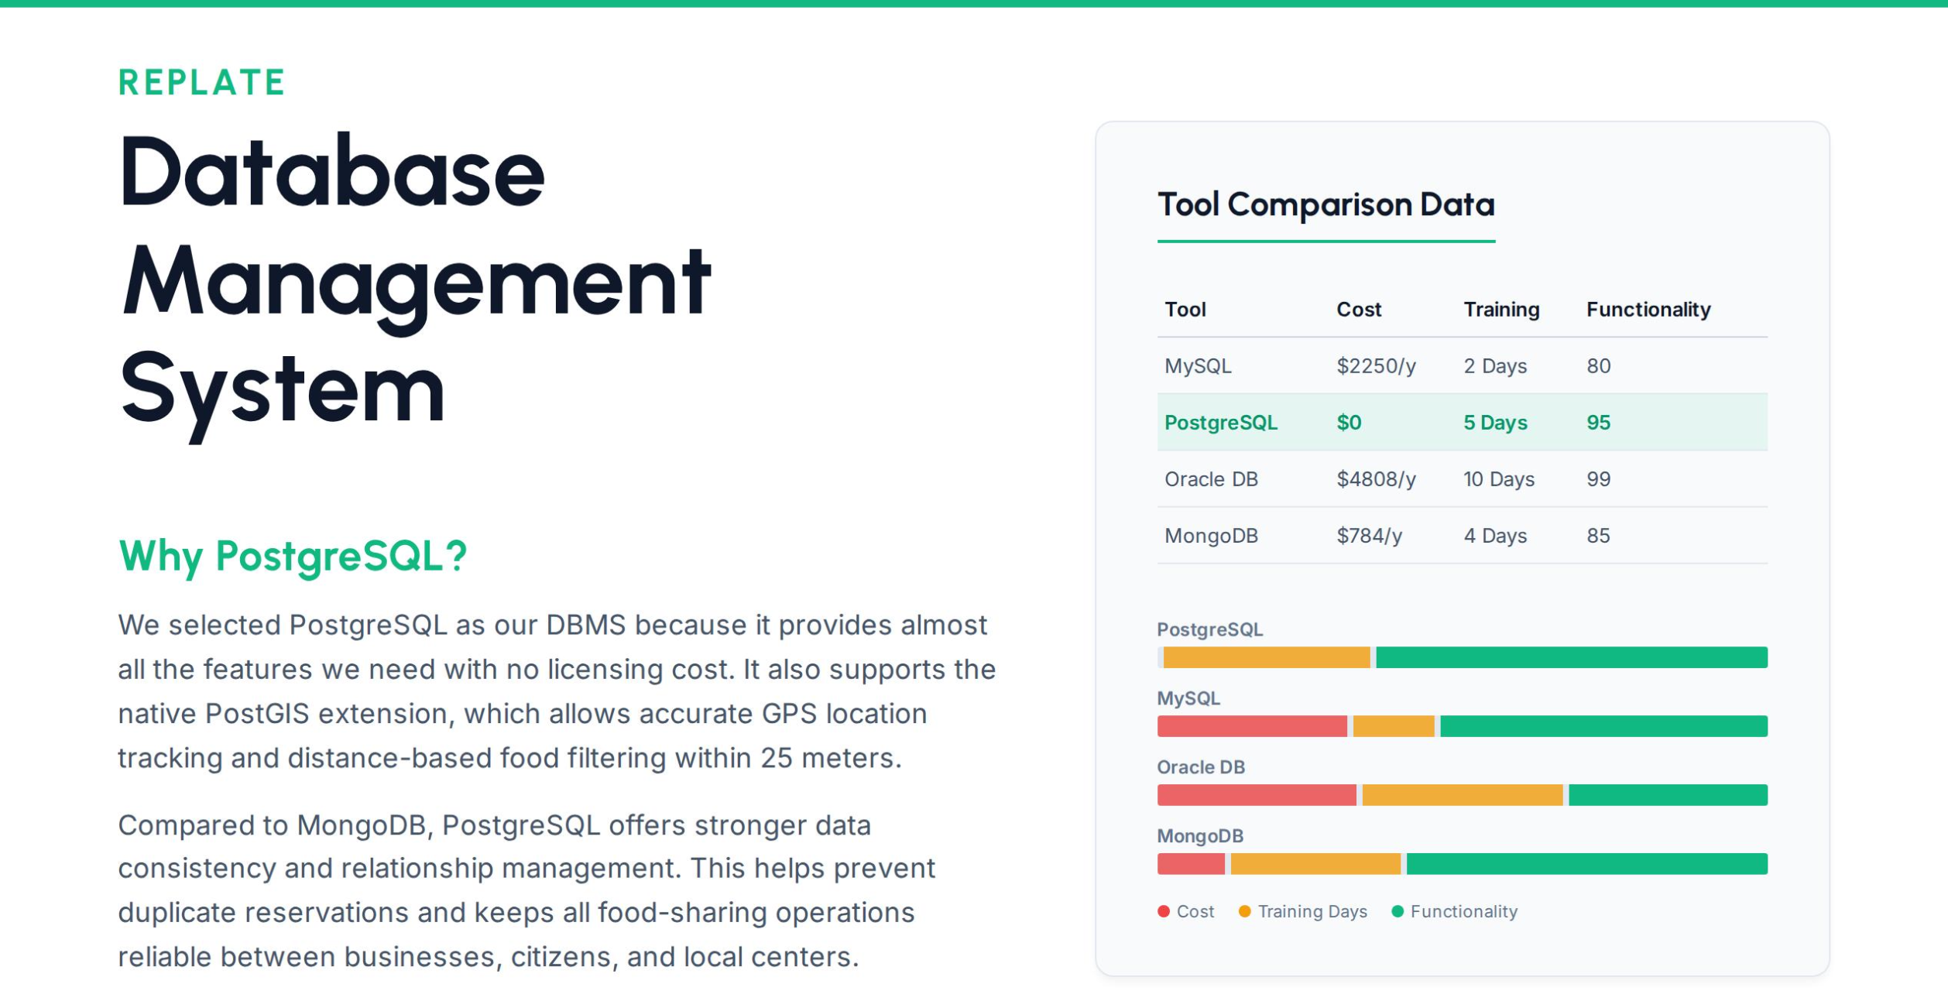
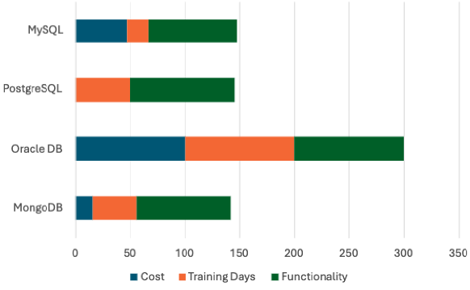

Slide 9
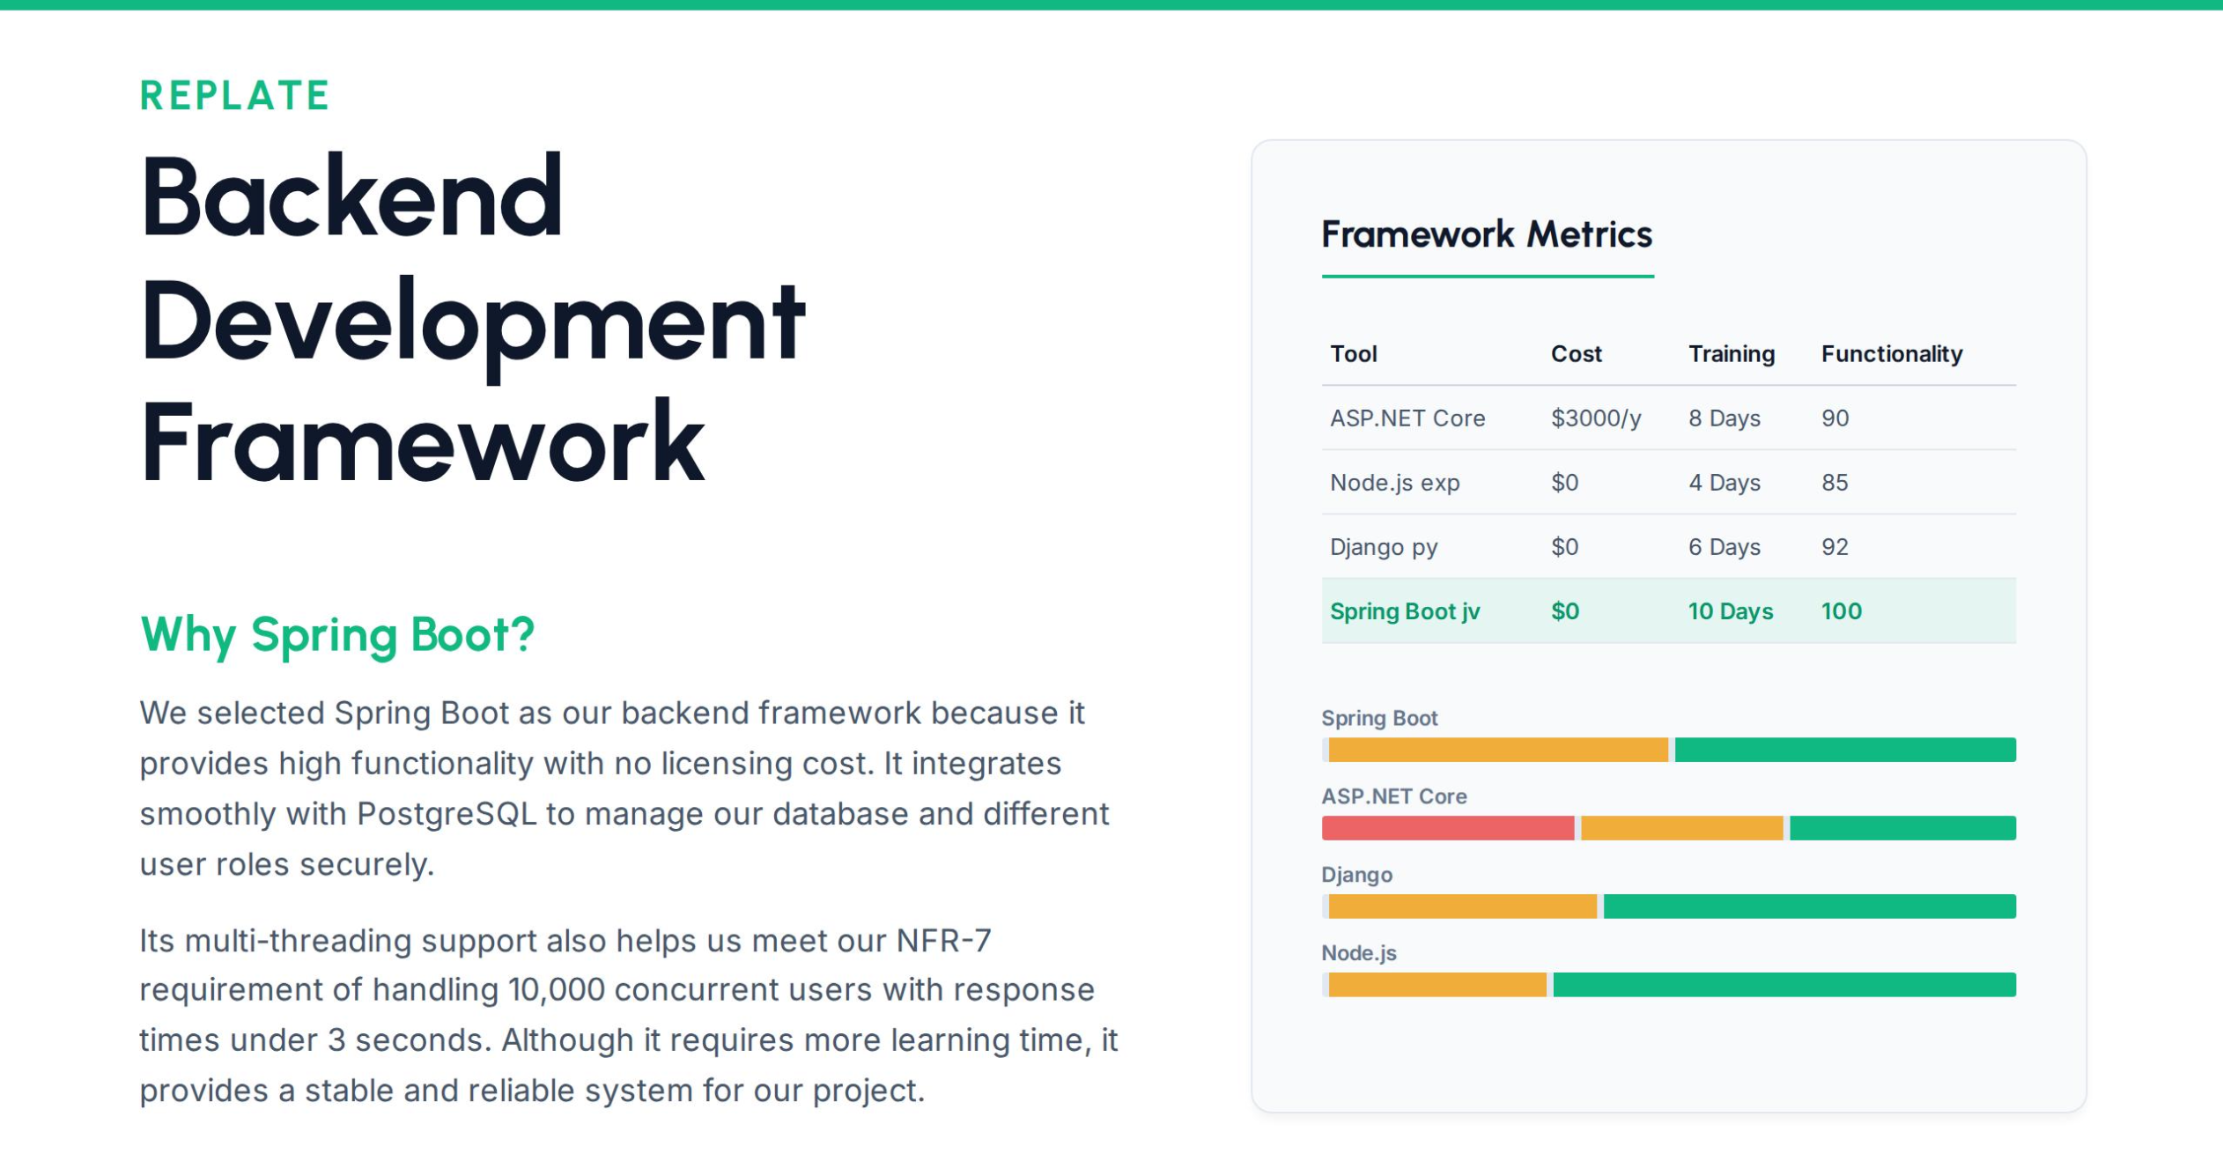

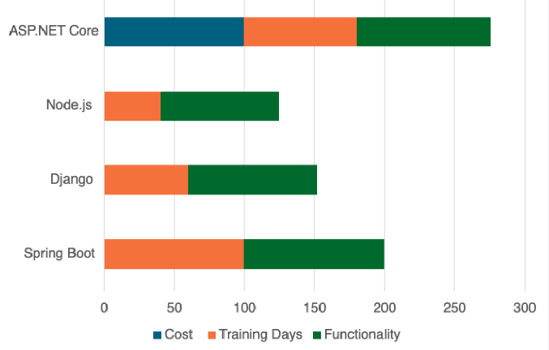

Slide 10
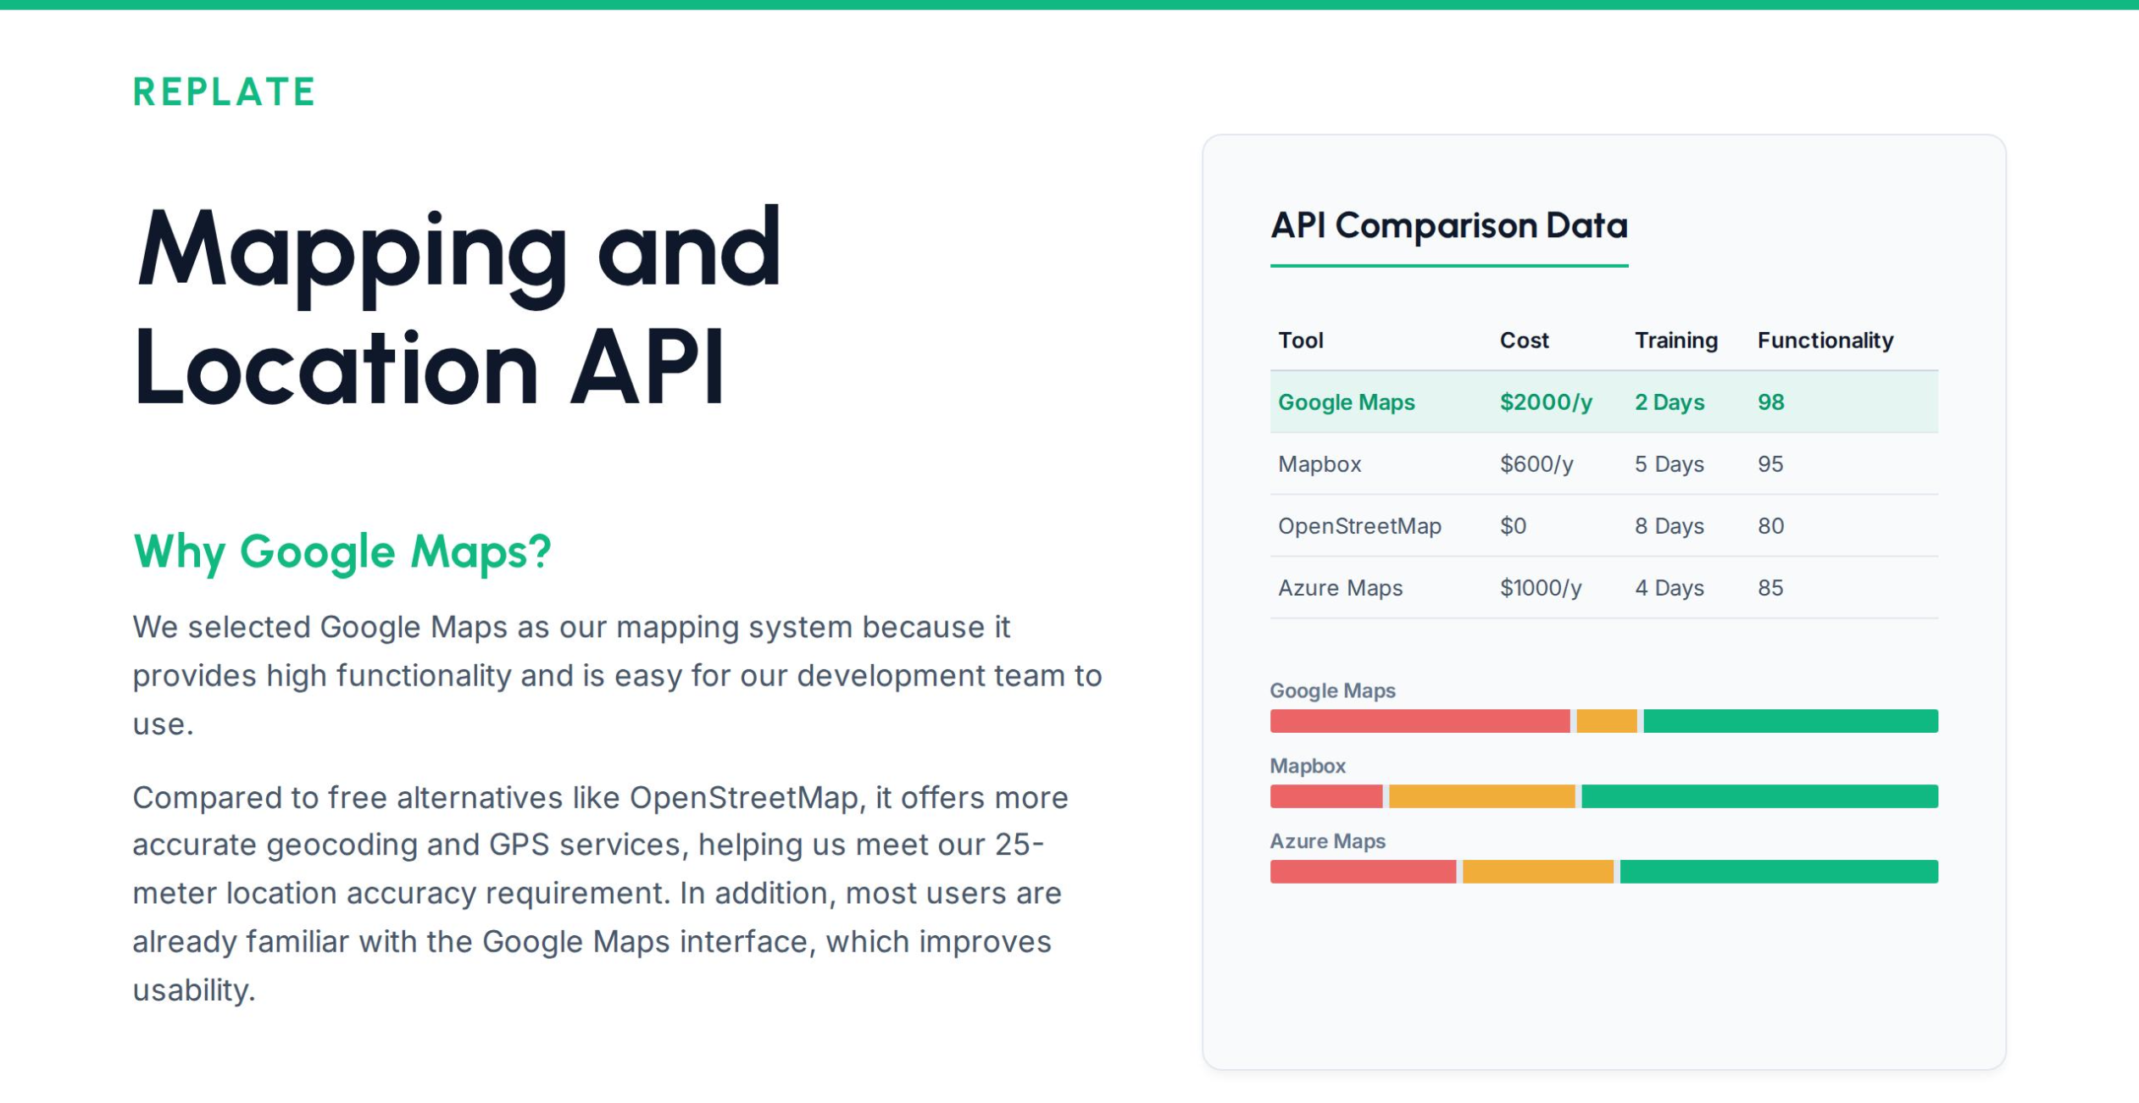
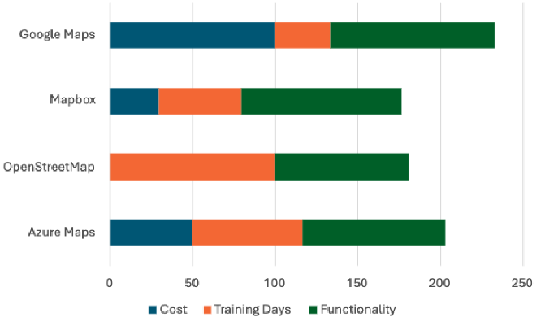




Slide 11
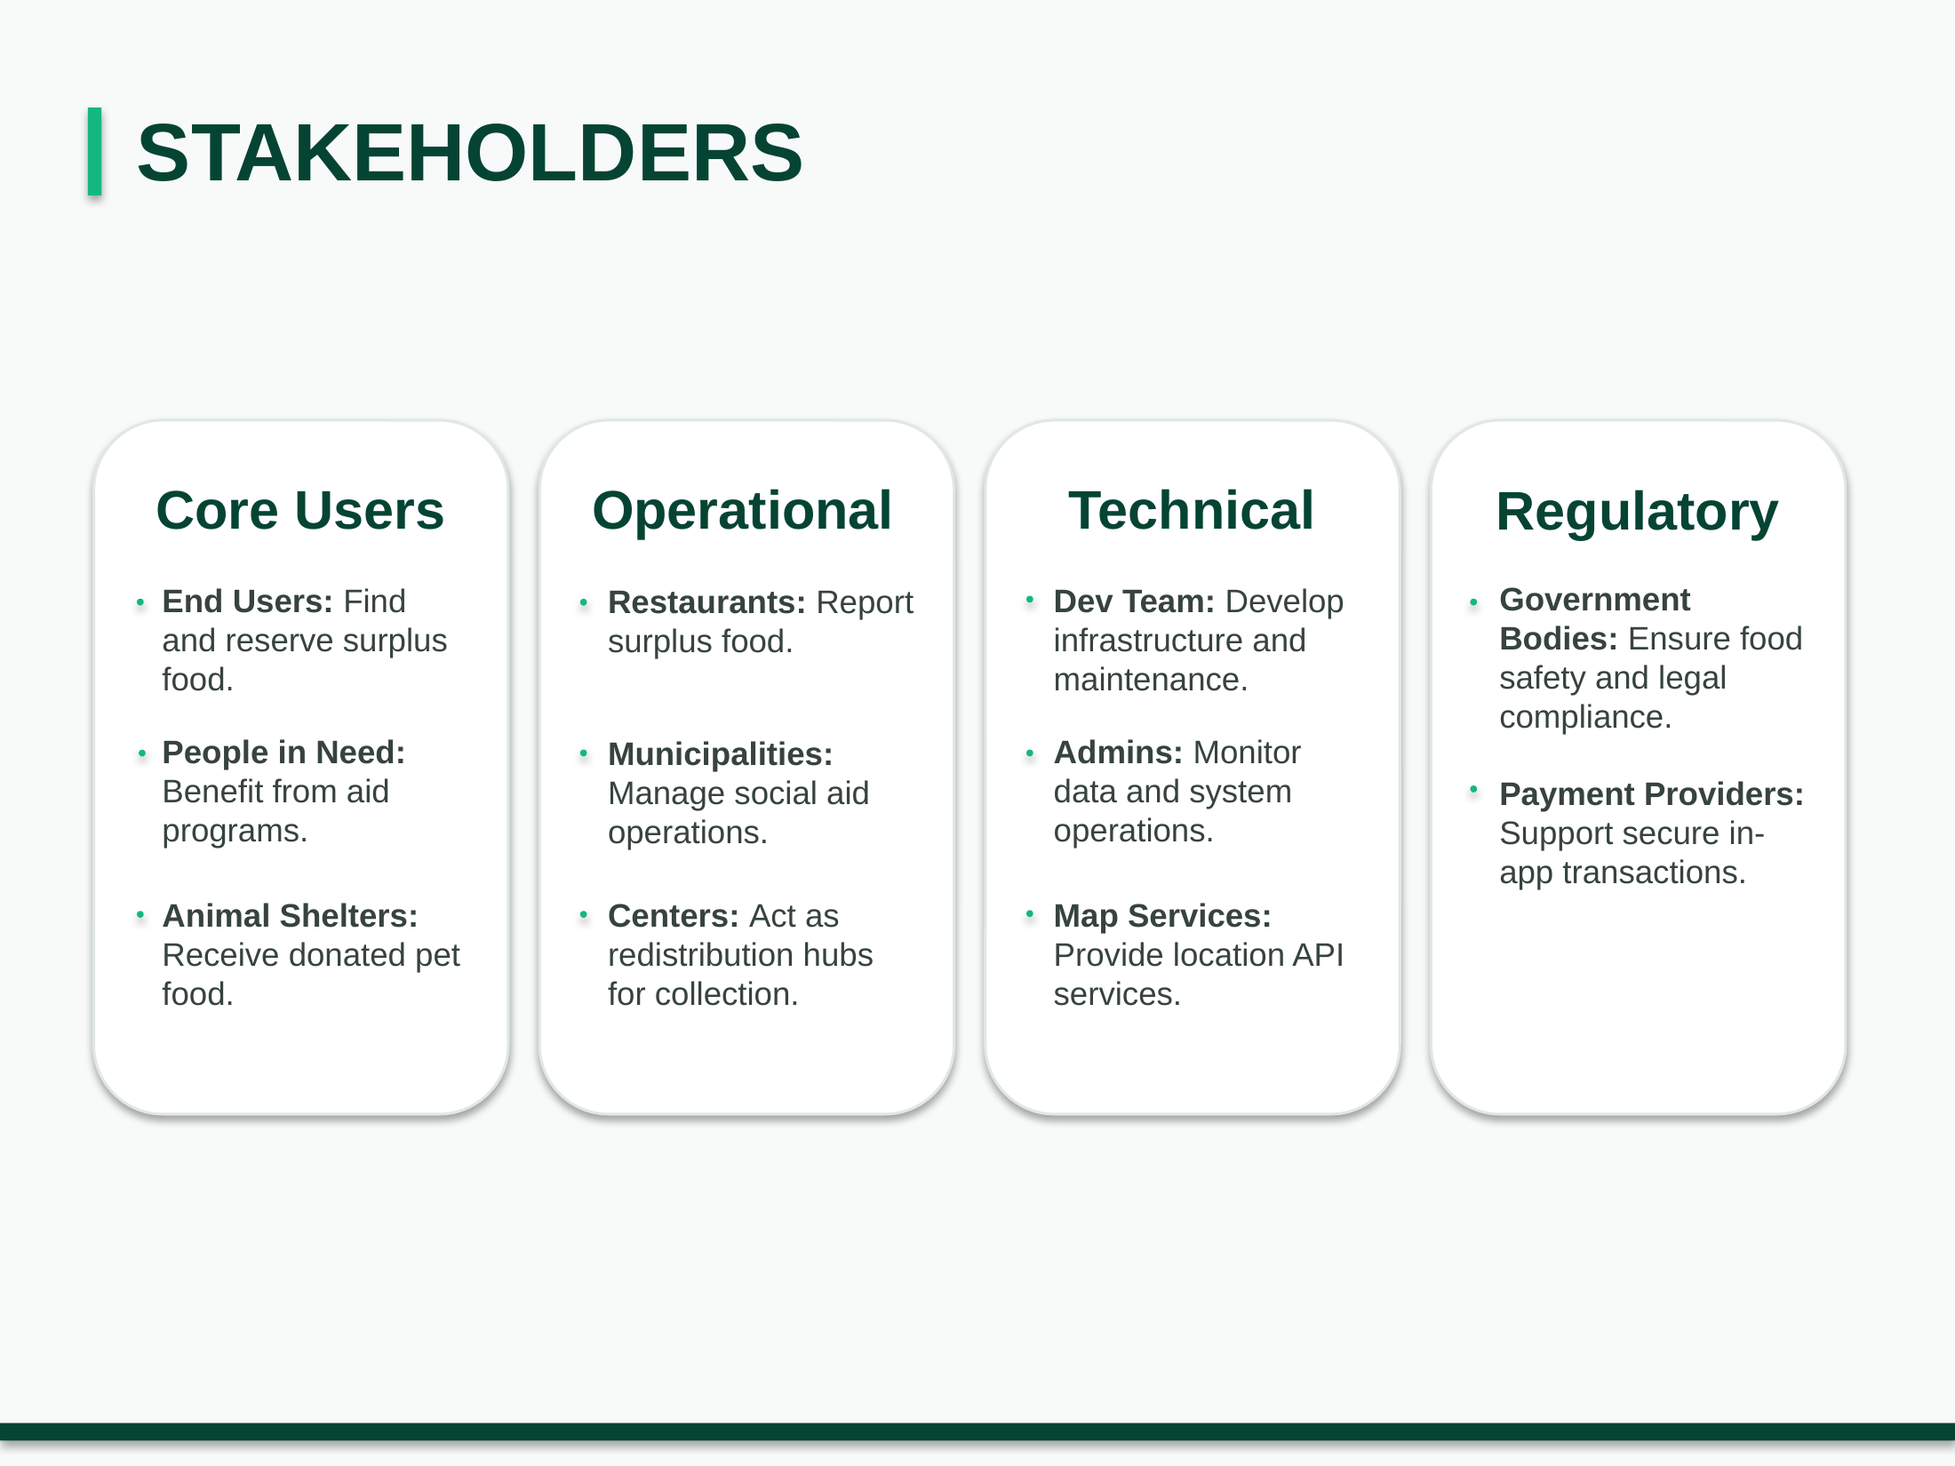

Slide 12
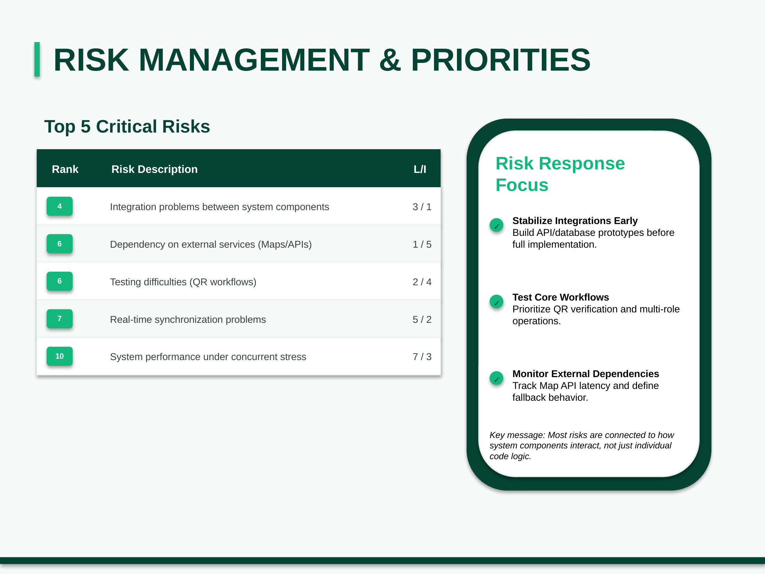

Slide 13











1. Code Reliability & Simulated Workflows
Automated Pass Rate
E2E Workflow Success
Ensuring core functionality via JUnit 5 and Mockito. The ultimate gatekeeper for CI/CD.
Validating the Whole User Journey from login to QR pickup for seamless integration.
Mockito isolates business logic, preventing external DB delays from causing false negative tests.
Simulated transactions run on a PostgreSQL test environment to ensure zero data loss.
QR Verification Rate
Simulated Cycle Time
Testing verification logic as an Isolated Subsystem using automated bot scripts.
Measuring UI/UX efficiency during UAT by digitalizing the delay between reservation and pickup.
Isolating this critical module helps identify decryption bottlenecks instantly.
Calculates timestamp differences directly from the database to prove interface fluidity.

Slide 14







2. System Resilience & Agile Quality
Concurrency Conflict
Sprint Velocity
Stress testing with Apache JMeter to simulate thousands of simultaneous virtual reservations.
Tracking the ratio of planned vs. completed Story Points to measure agile team efficiency.
Validates our Optimistic Locking mechanism in preventing race conditions.
Using GitHub Projects as our Single Source of Truth minimizes context switching.
API Response Latency
Defect Density
Proactive monitoring of Google Maps API so third-party delays don't create blind spots.
Evaluating code health by standardizing bug counts against physical codebase size.
Powered by Spring Boot Actuator, scraped by Prometheus, visualized on Grafana.

Slide 15
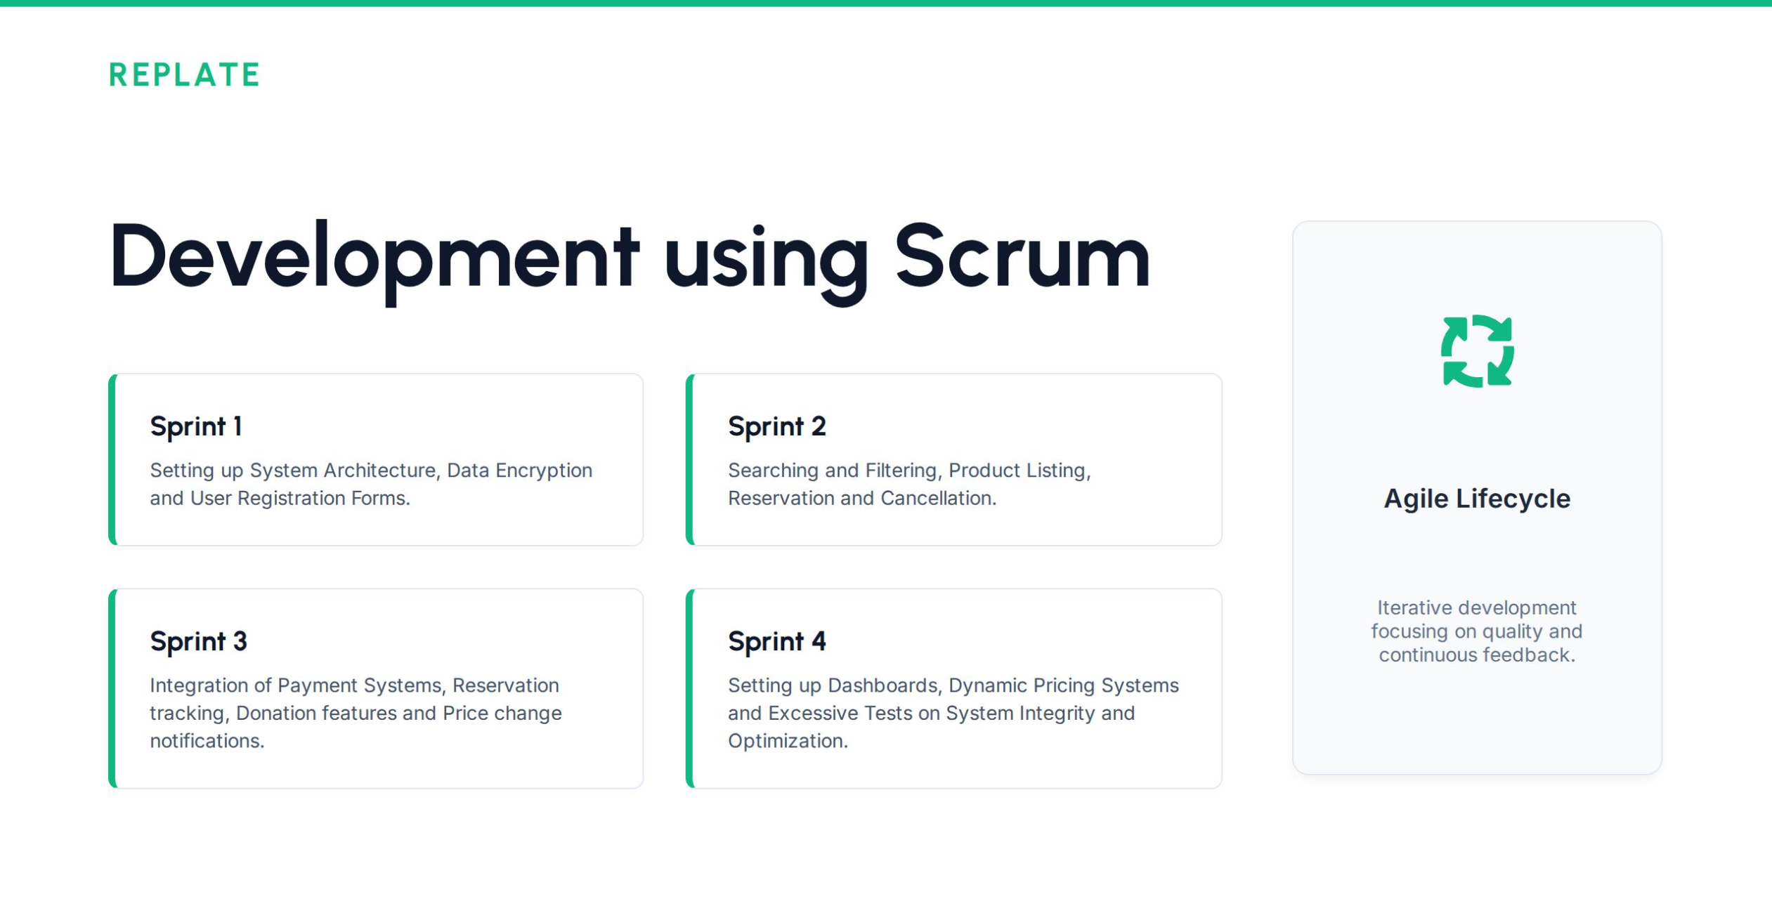

Slide 16
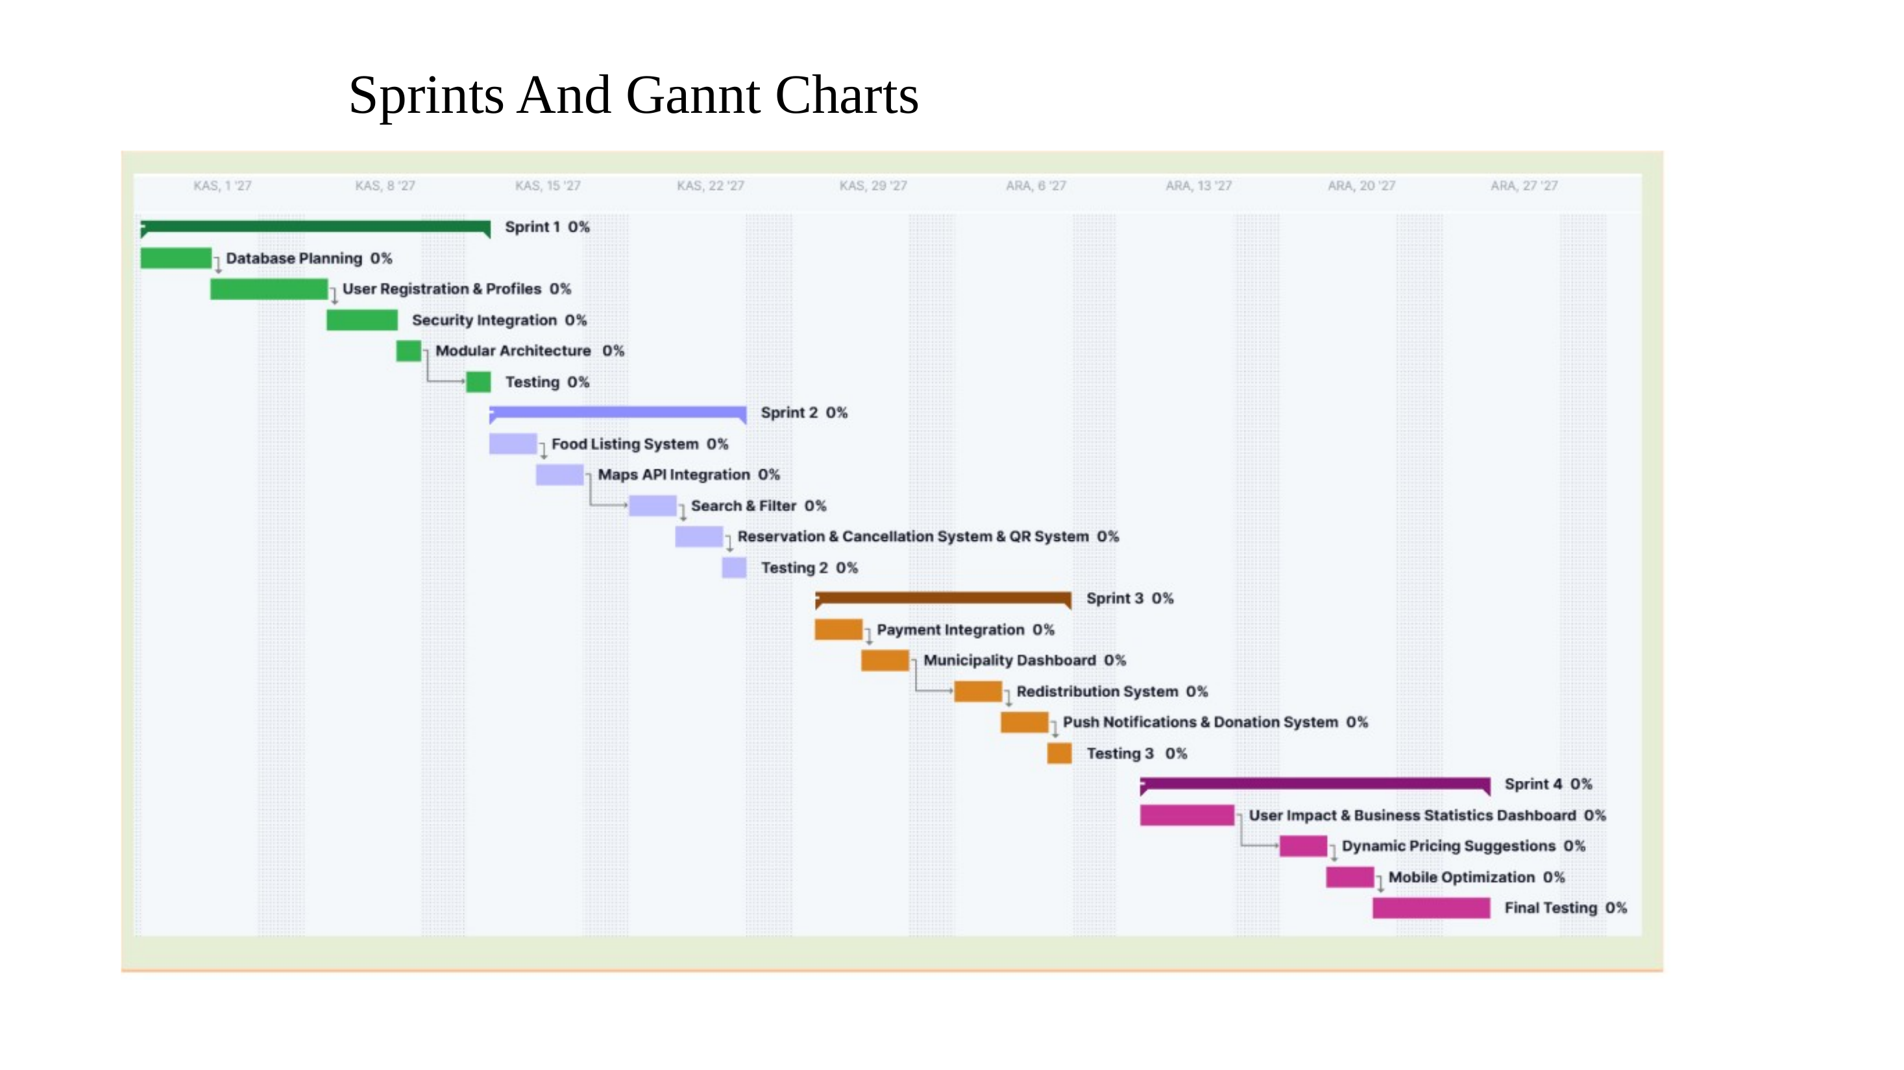

Slide 17
REPLATE
Conclusion
Final project outcome and expected value
RePlate is designed as a traceable food redistribution platform that connects businesses, municipalities and citizens in one coordinated system.
01
Reduces Food Waste
02
Supports Communities
03
Improves Coordination
04
Measures Real Impact
Surplus food is listed, reserved, transferred or donated instead of being discarded.
Affordable meals, donation flows and pet food support create direct social benefit.
Businesses and municipalities share stock, transfers and redistribution data in one system.
Dashboards track meals rescued, money saved, donation volume and environmental impact.
Final Takeaway
By combining real-time listing, QR-based pickup verification, municipal redistribution and measurable impact analytics, RePlate turns surplus food into an organized, testable and scalable social value system.
RePlate · SE 216 Software Project Management · Group 7
17

